Slide 1

Web technologies using java
Course 9 – JPA / Hibernate

Slide 2
agenda
JPA / hibernate Overview
JPA Architecture
Entities
relationships

Slide 3
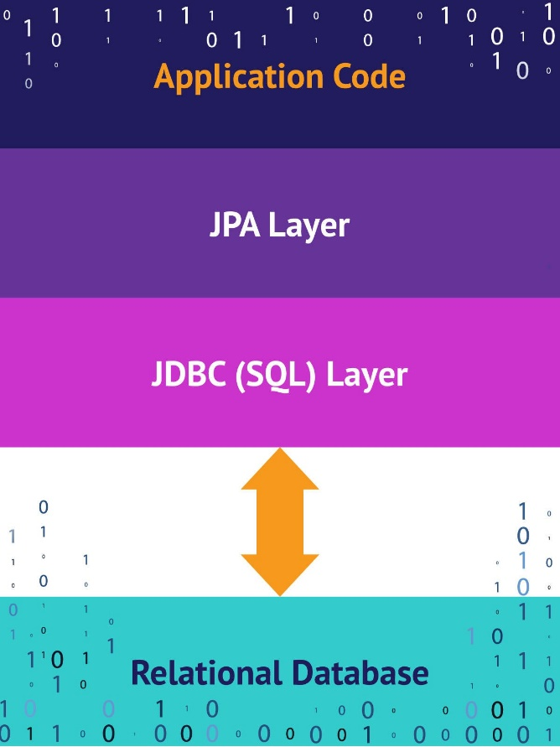
Jpa / hibernate overview
JPA is a specification that lets you define which objects should be persisted, and how those objects should be persisted in your Java applications.
JPA defines a set of concepts that can be implemented by any tool or framework.
Every JPA implementation provides an ORM layer.
The ORM layer converts Java classes and objects so that they can be stored and managed in a relational database:
Names of persisted objects --> tables
Fields of persisted objects --> columns
Objects --> rows
Hibernate is a JPA implementation.

Slide 4
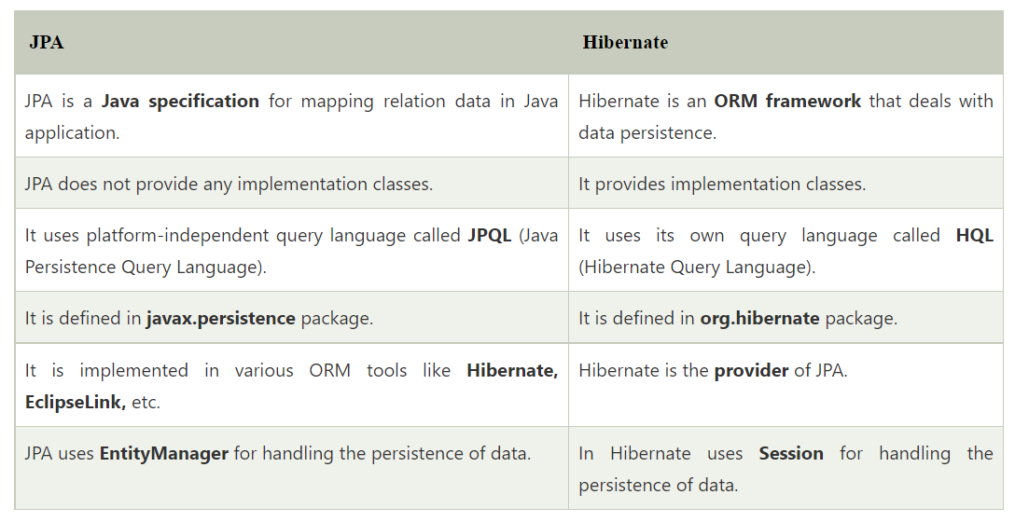
Jpa / hibernate overview

Slide 5
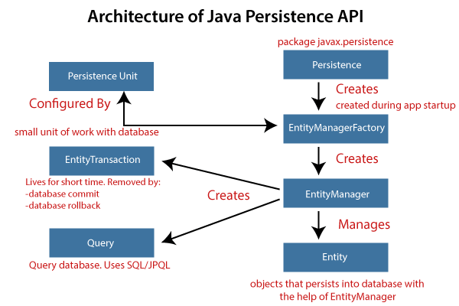
Jpa architecture

Slide 6
entities
@Entity
@Table
@Column
@Id
@Enumerated

Slide 7
relationships
@OneToOne
@OneToMany
@ManyToOne
@ManyToMany
May be unidirectional or bidirectional.

Slide 8
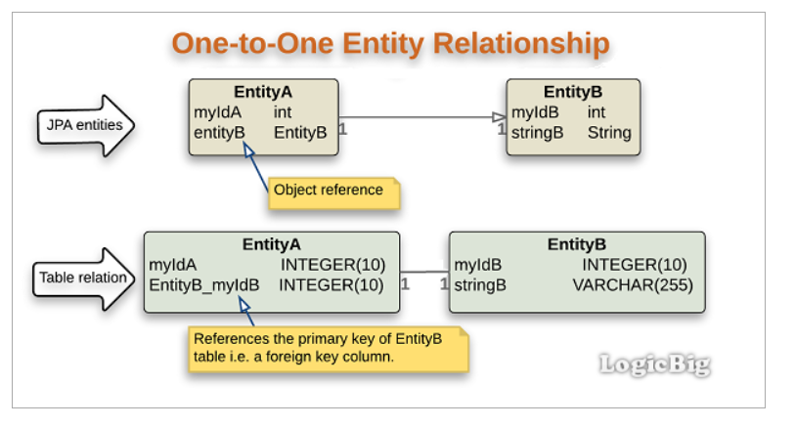
relationships

Slide 9
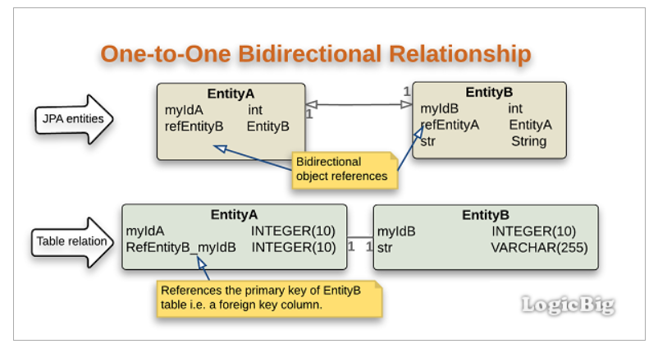
relationships

Slide 10
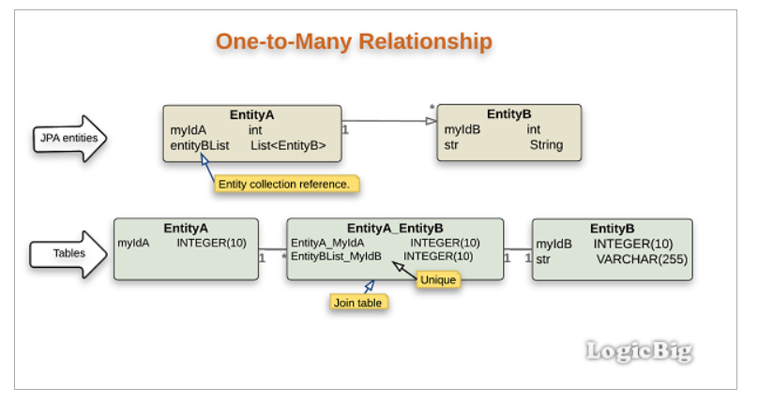
relationships

Slide 11
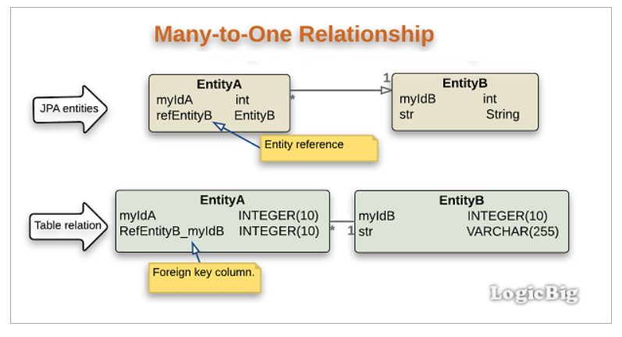
relationships

Slide 12
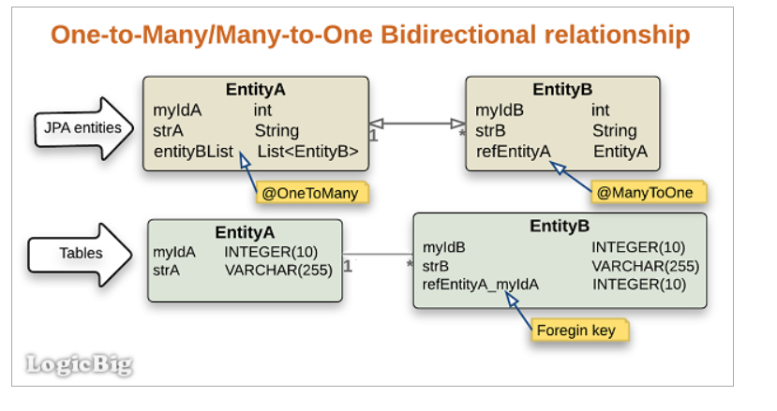
relationships

Slide 13
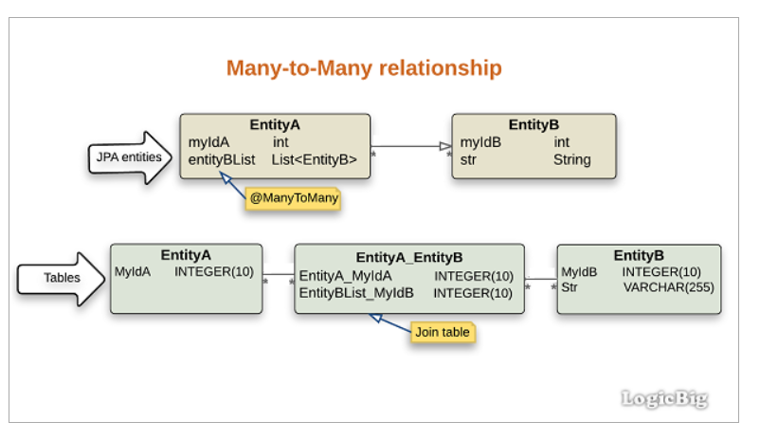
relationships

Slide 14
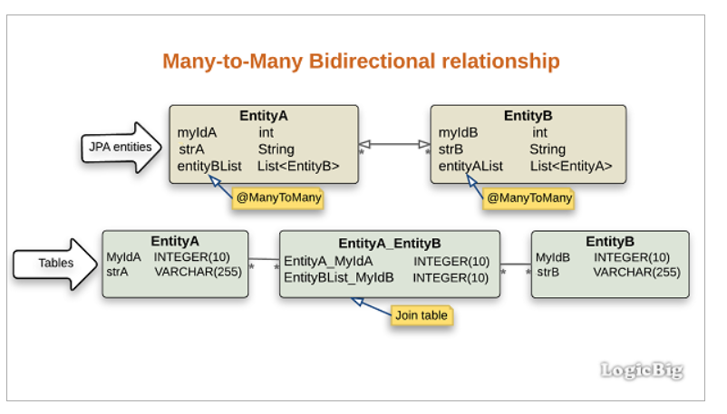
relationships

Slide 15
bibliography
Spring in Action, by Craig Walls
Spring REST, by Balaji Varanasi, Sudha Belida
Pro JPA 2, Mike Keith, Merrick Schincariol

Slide 16

Q&A

Slide 17
THANK YOU
DANIELA spilcĂ

